Slide 1


Introduction to Software Engineering
Assignment 1

Slide 2
Nagham Wael Mohamed 20231189
Fatema El-Zhraa Ahmed Mohamed El-Fiky 20230280
Aly El-Deen Yasser Ali 20231109

Slide 3
Java Programs

Slide 4
Aly El-Deen Yasser Aly:
Hours of Study: 18 hours
Source of study https://youtube.com/playlist?list=PLCInYL3l2AajYlZGzU_LVrHdoouf8W6ZN&si=tfRlF2iNxOtJehum
Video Link: https://youtu.be/-brwmS8jSZo

Slide 5
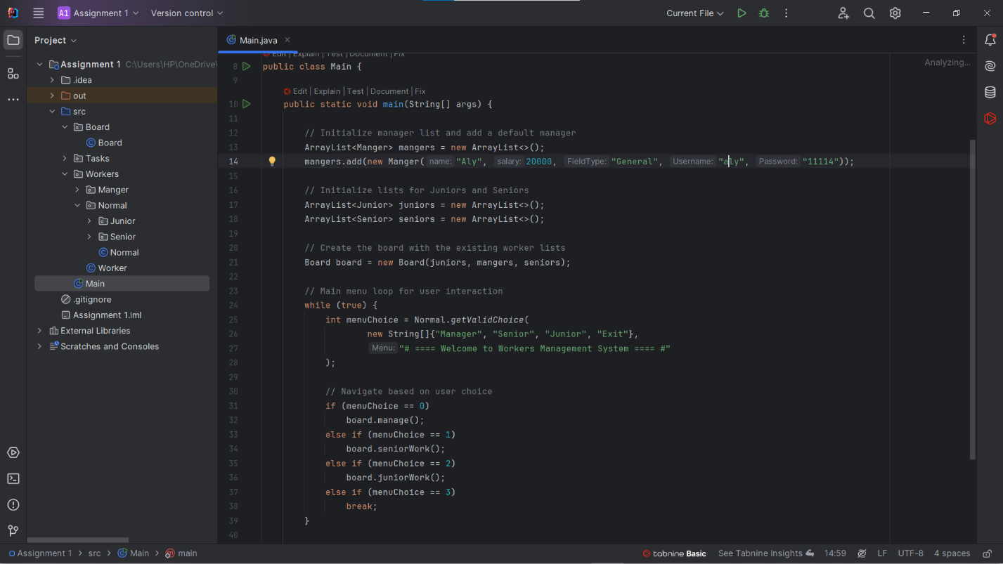

Slide 6
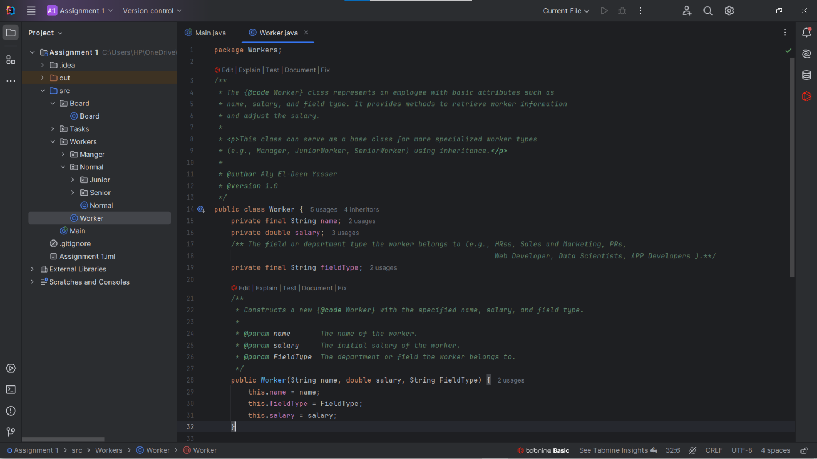

Slide 7
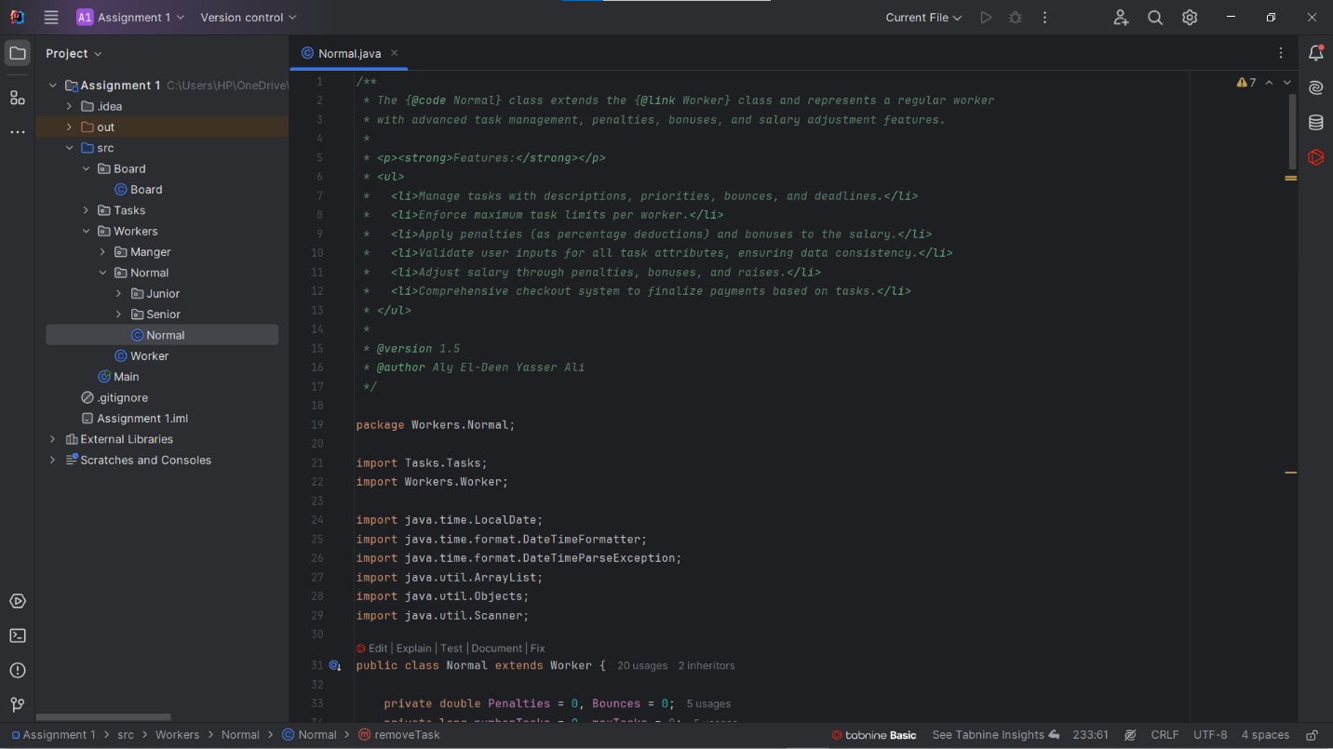

Slide 8
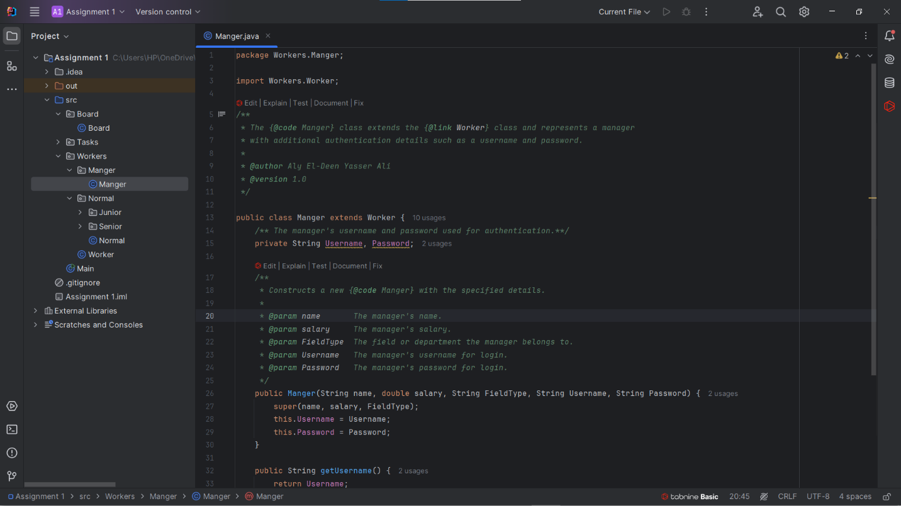

Slide 9
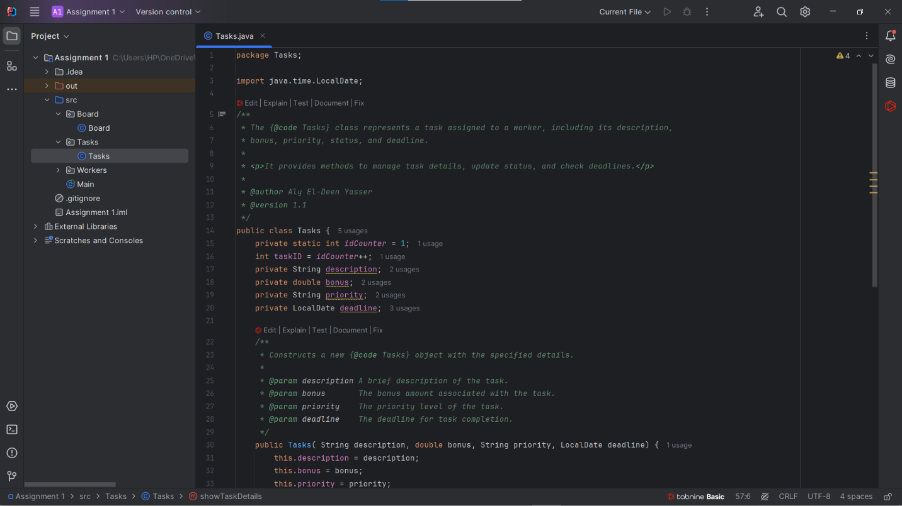

Slide 10
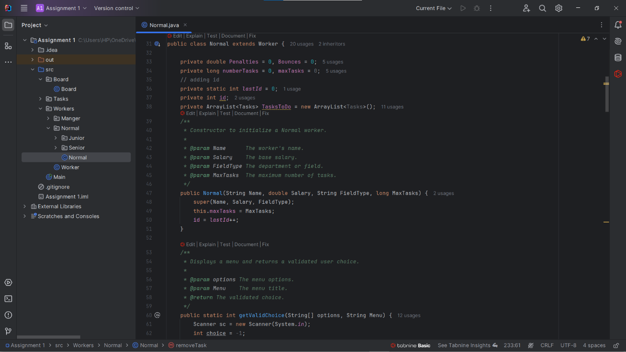

Slide 11
Nagham Wael:
Hours of Study: 12h
Source of Study: Geeks For Geeks + https://youtube.com/playlist?list=PLCInYL3l2AajYlZGzU_LVrHdoouf8W6ZN&si=tfRlF2iNxOtJehum
Video Link: https://youtu.be/VqOBuBvfRiw?si=WCep92XFi12x7LnN

Slide 12
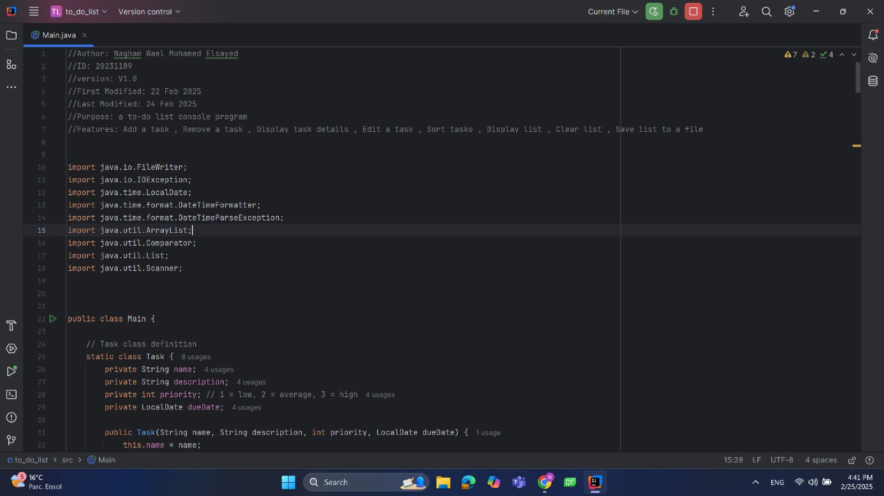

Slide 13
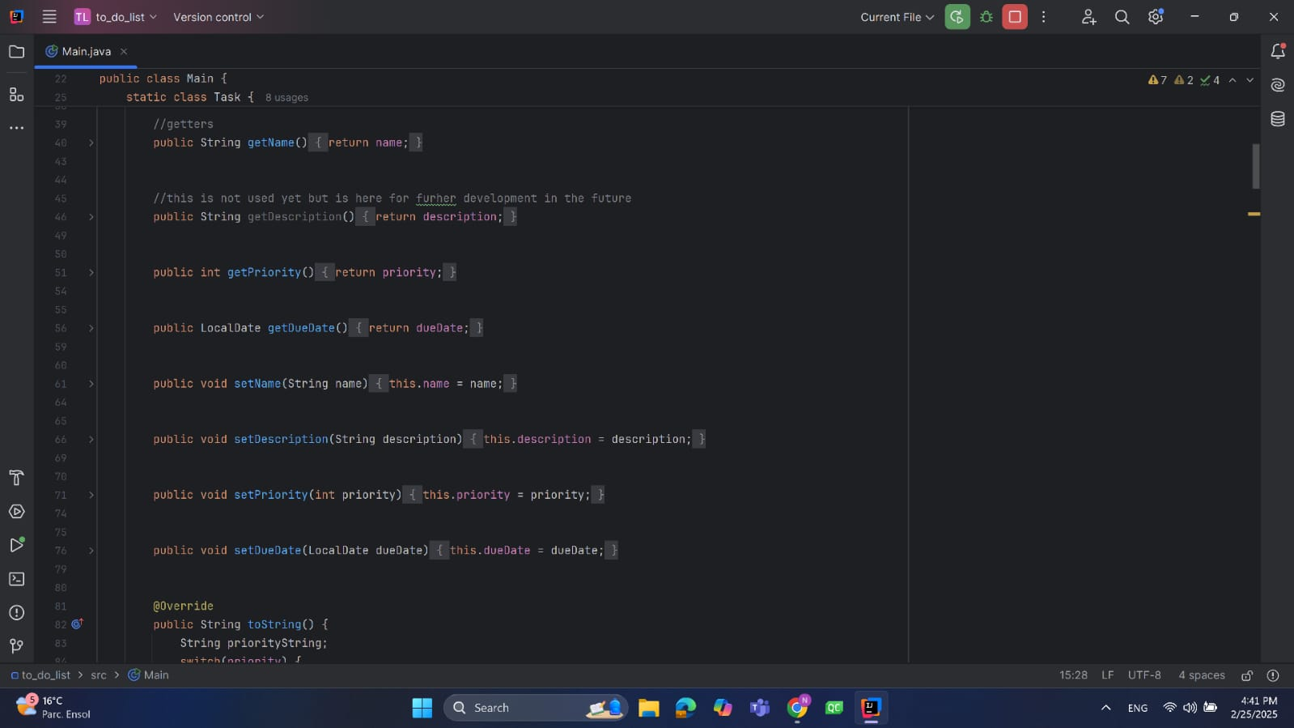

Slide 14
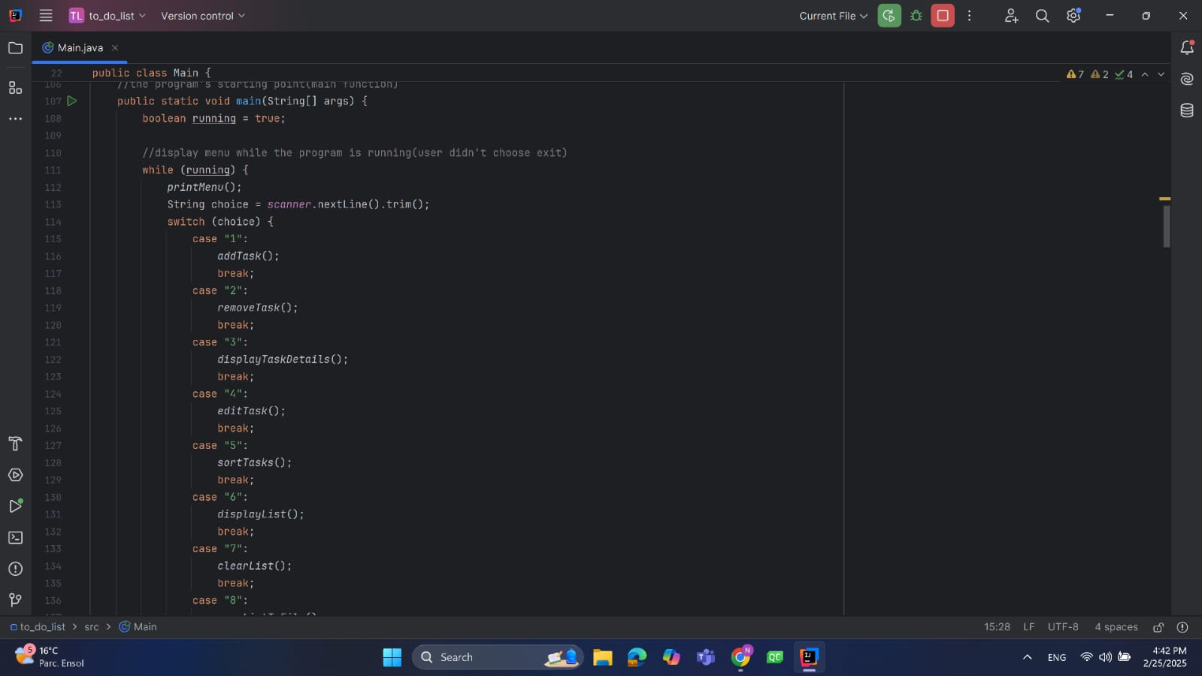

Slide 15
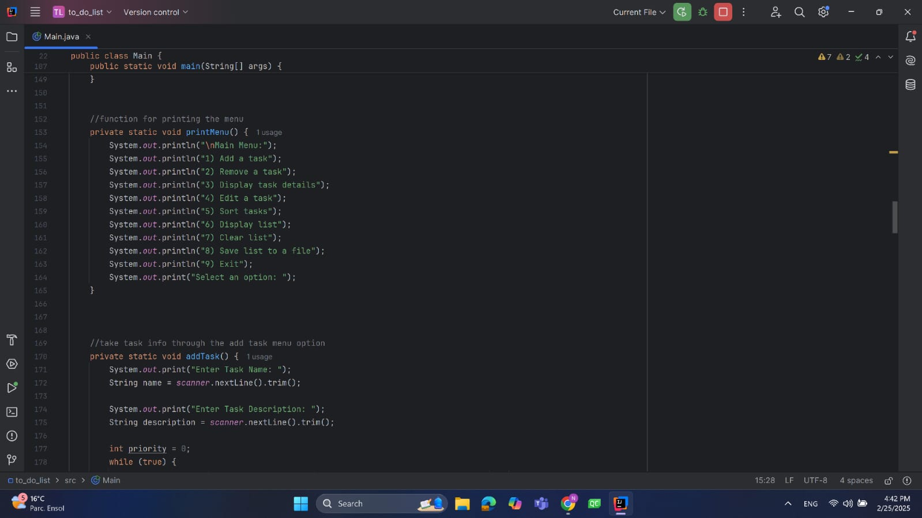

Slide 16
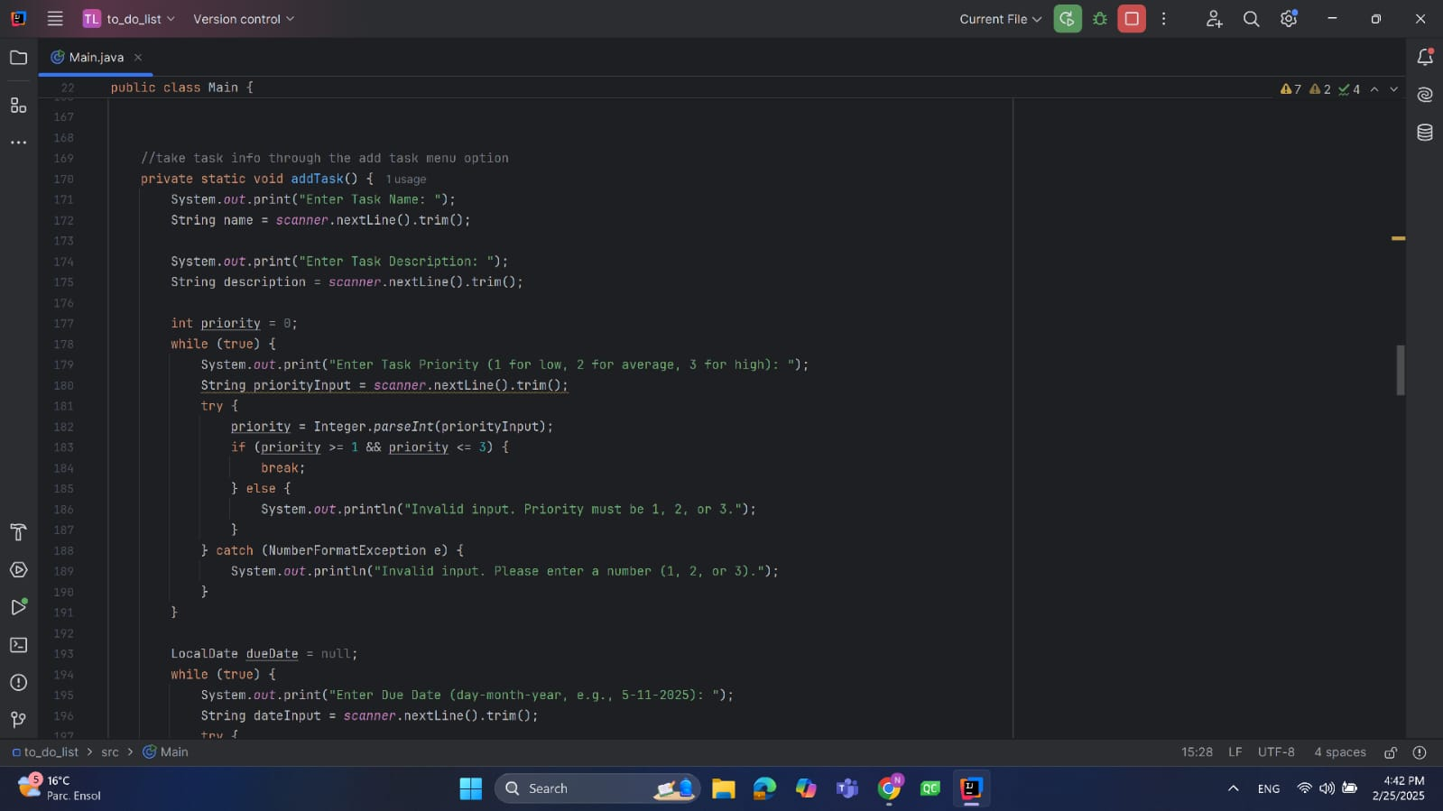

Slide 17
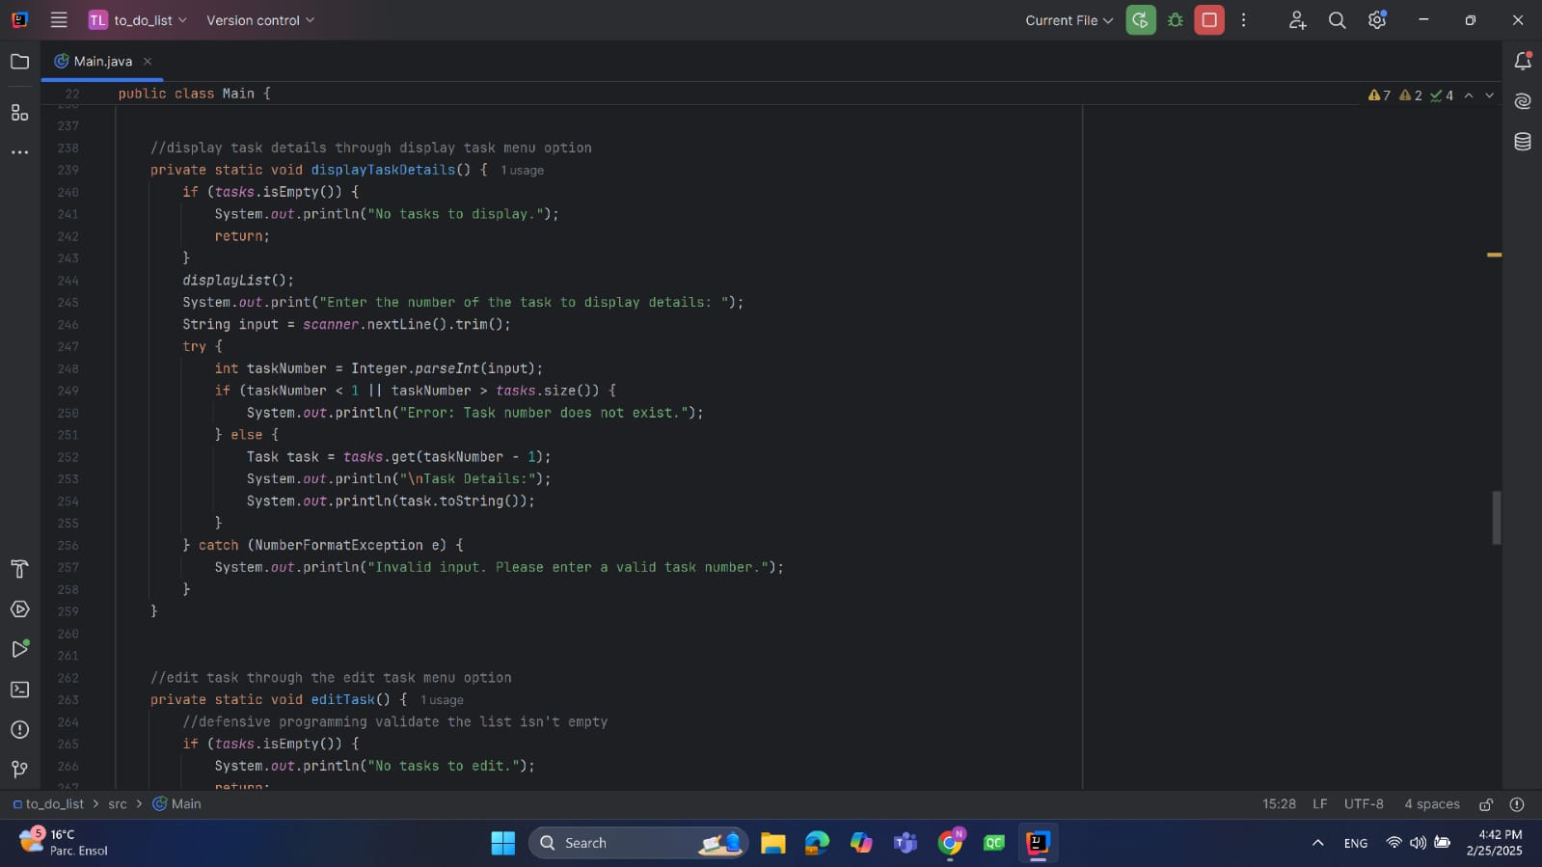

Slide 18
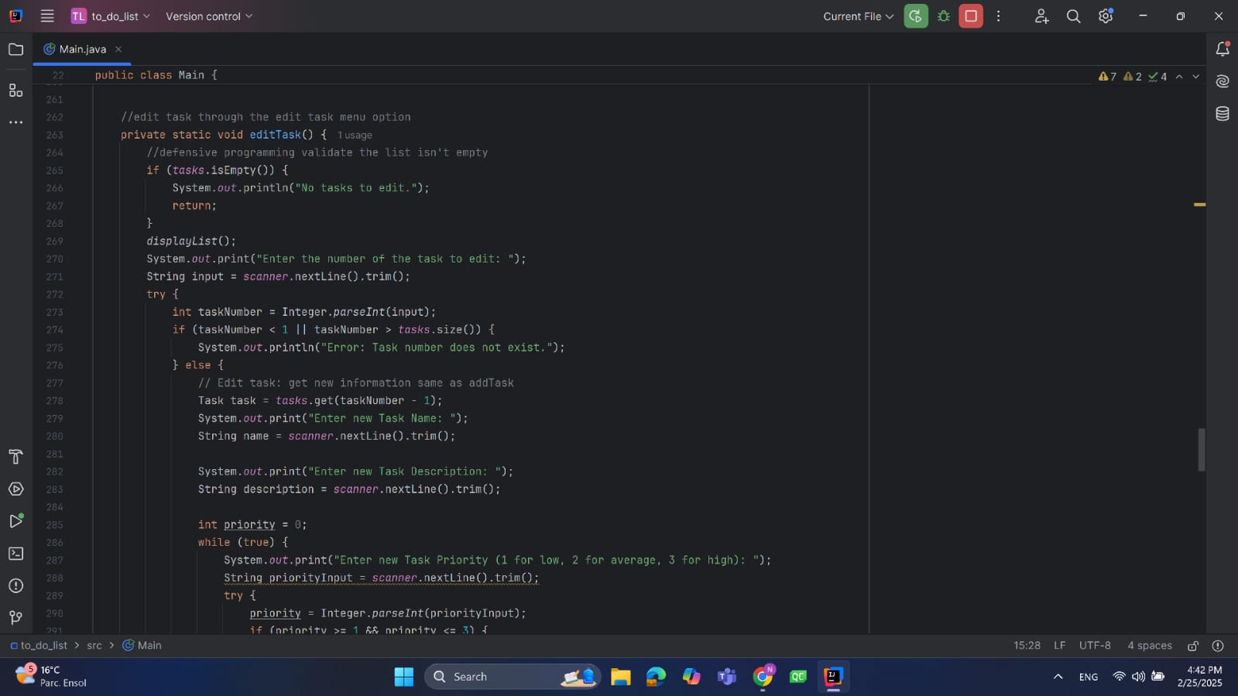

Slide 19
Fatema El-Zhraa Ahmed:
Hours of Study:12 hours
Source of Study : https://www.youtube.com/playlist?list=PLCInYL3l2AajYlZGzU_LVrHdoouf8W6ZN
Video Link: https://www.youtube.com/watch?v=fuV9C_FRDf8

Slide 20
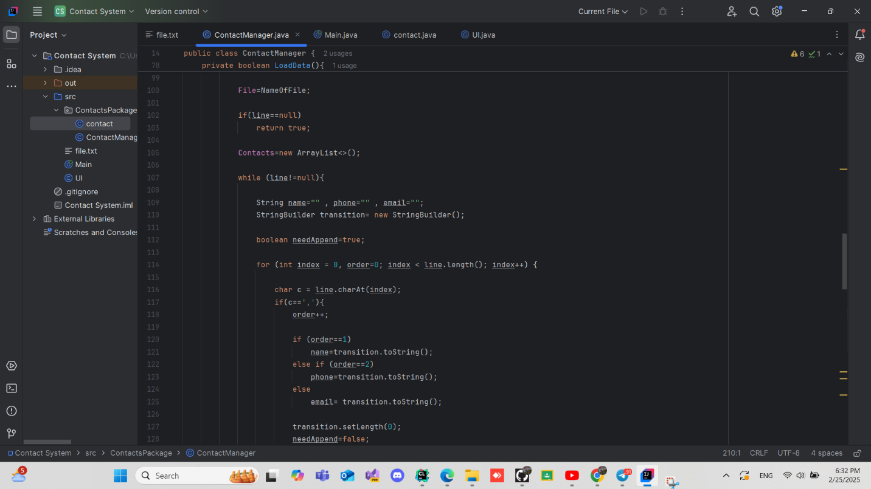

Slide 21
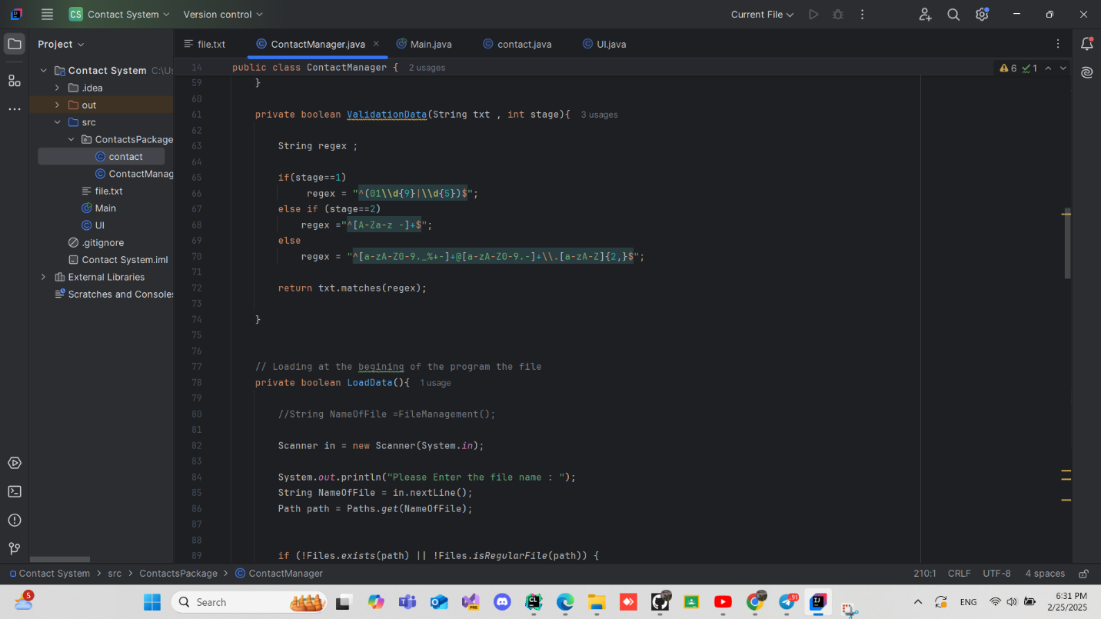

Slide 22
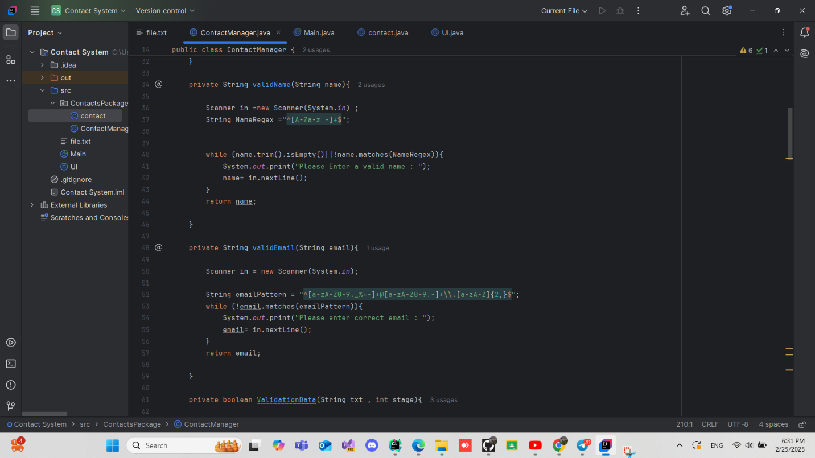

Slide 23
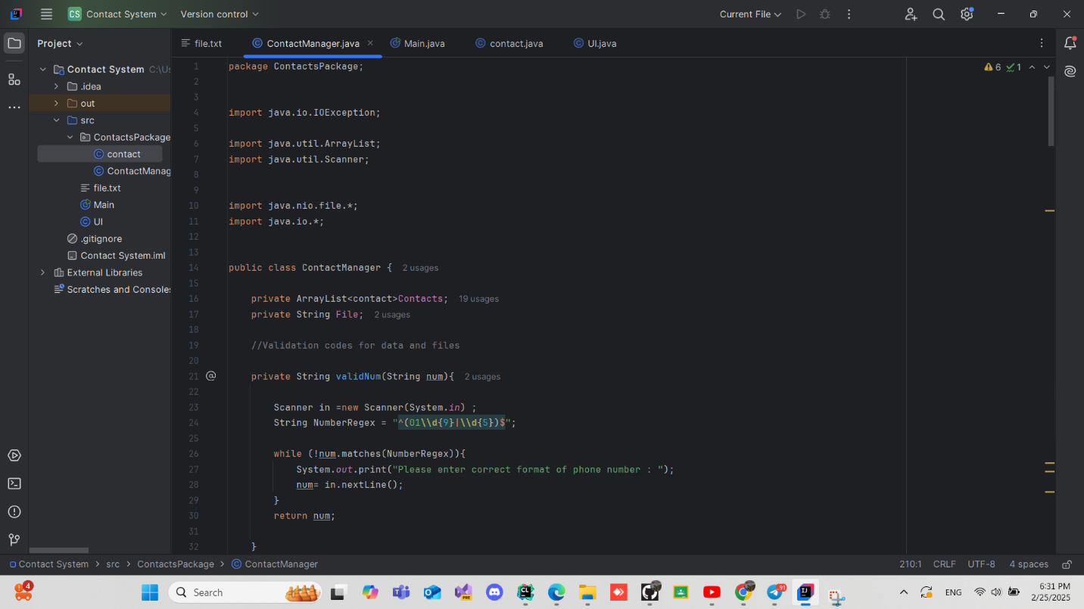

Slide 24
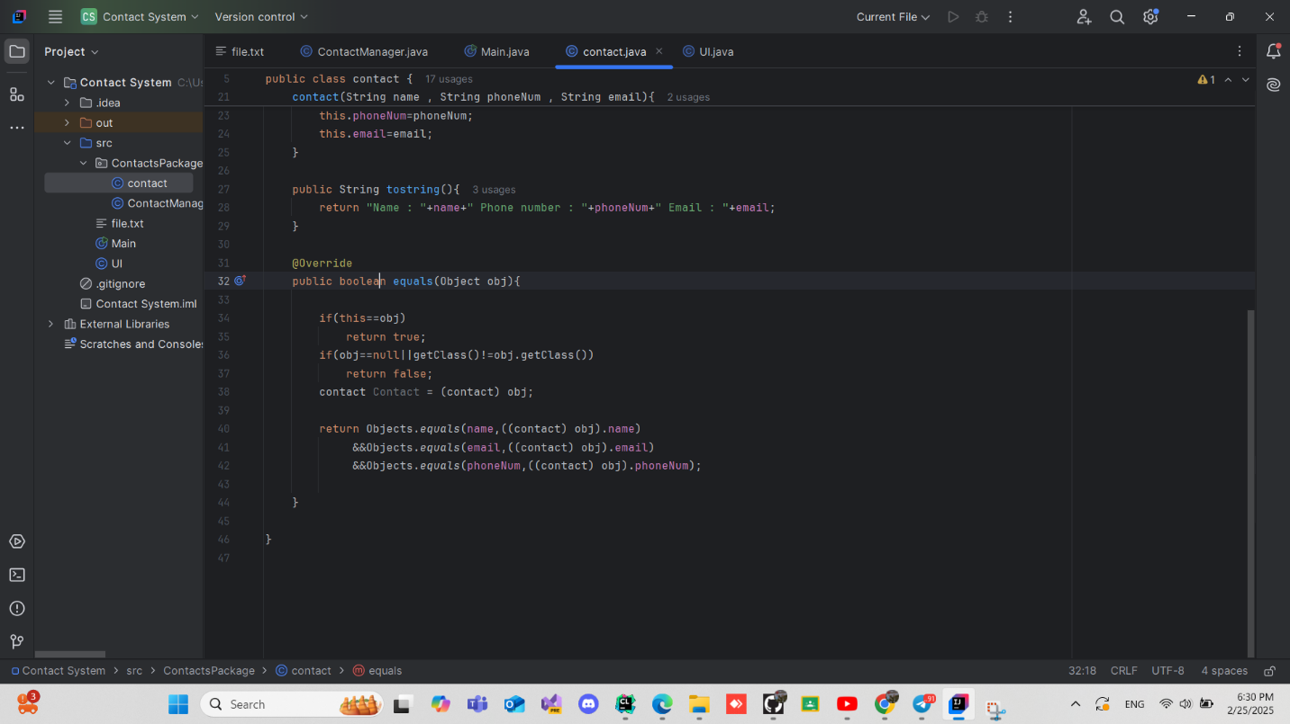

Slide 25
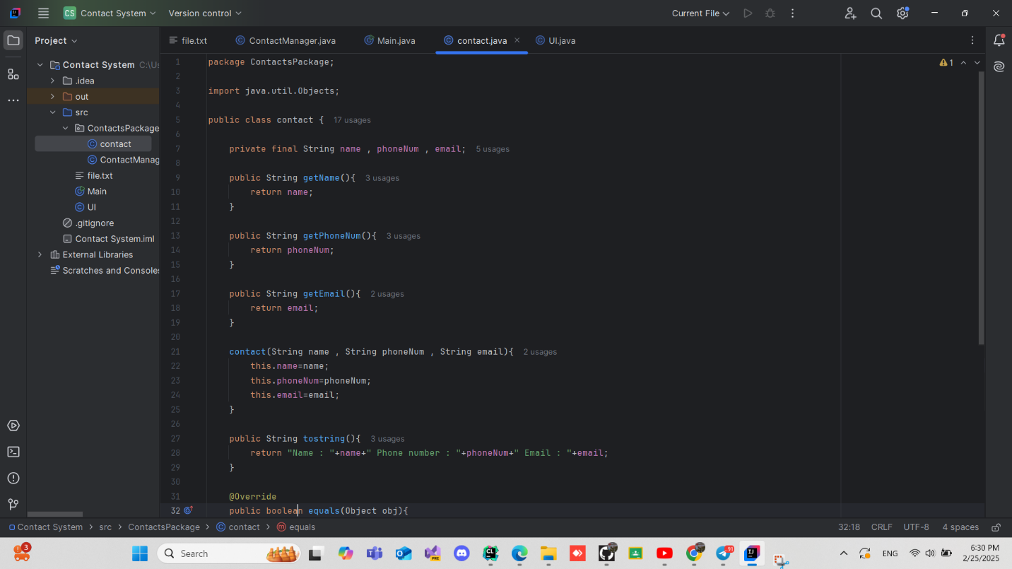

Slide 26
LCNC

Slide 27
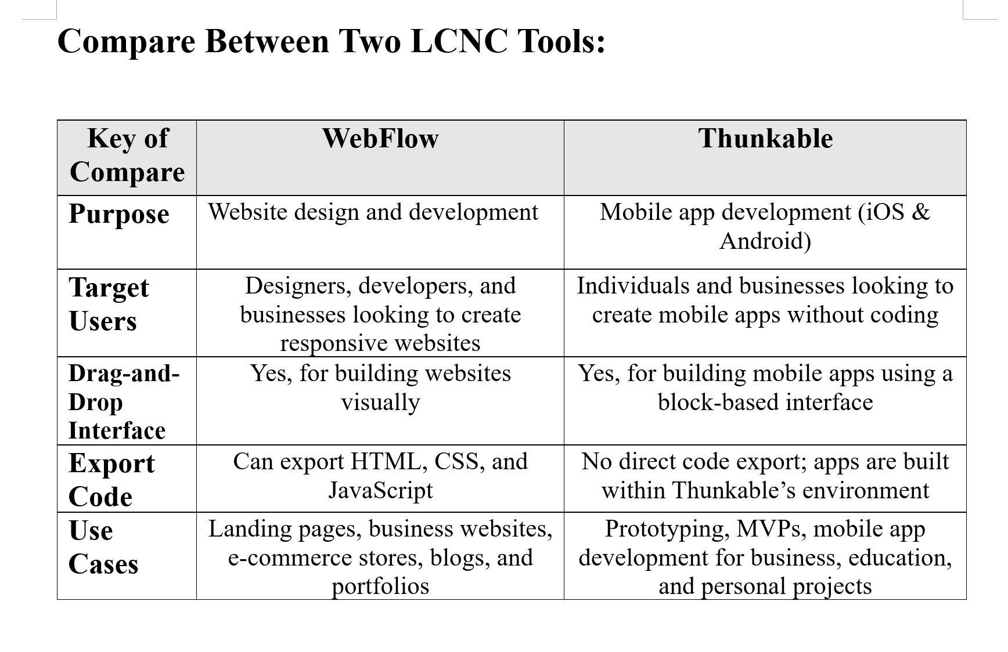

Slide 28
Website link : https://the-house-web.webflow.io/products
Video link: https://youtu.be/c071WQAifNM?si=sWq_lknsMG3GbJbN

Slide 29
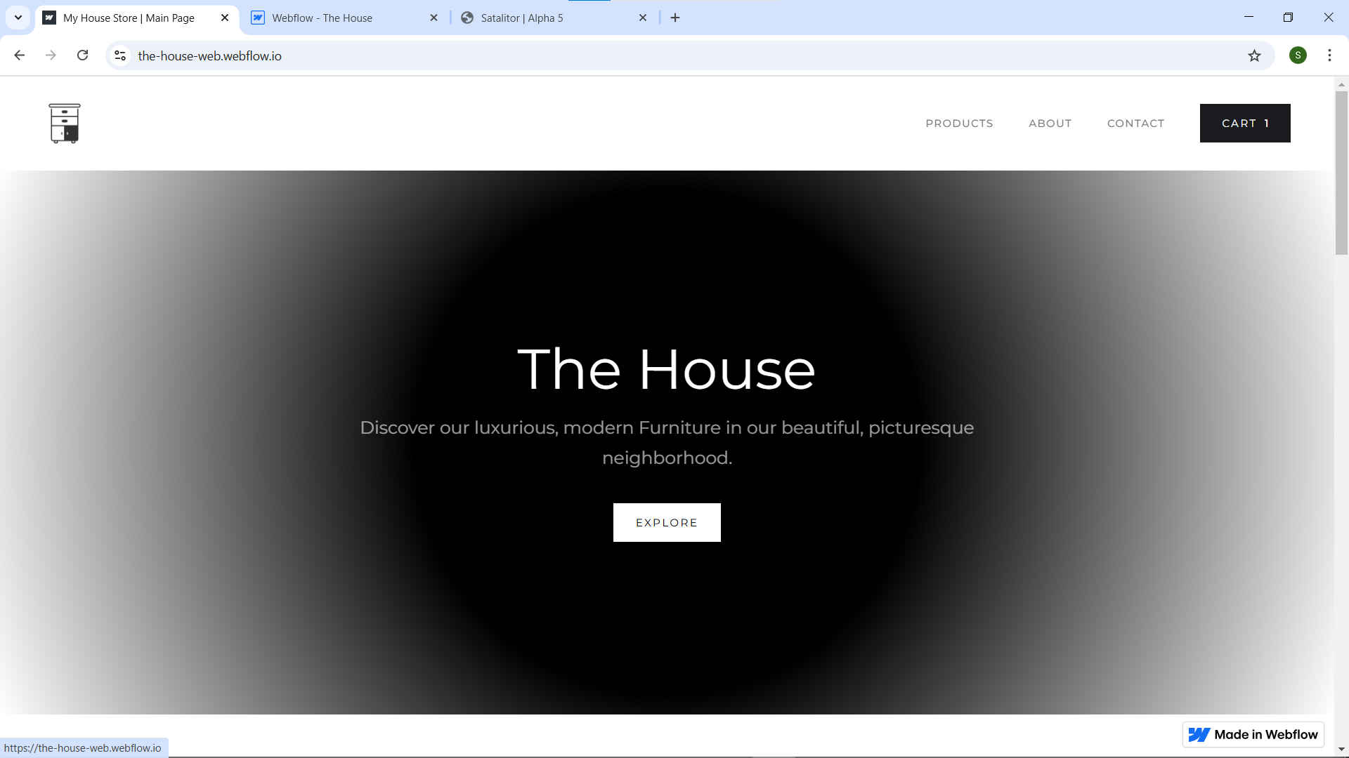

Slide 30
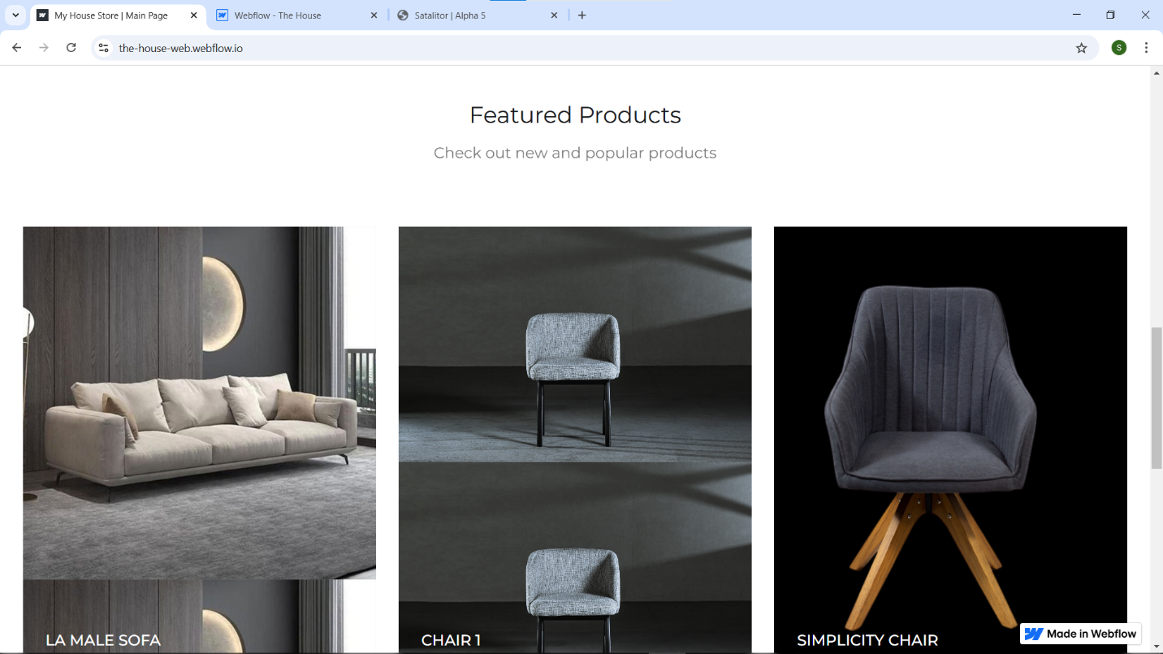

Slide 31
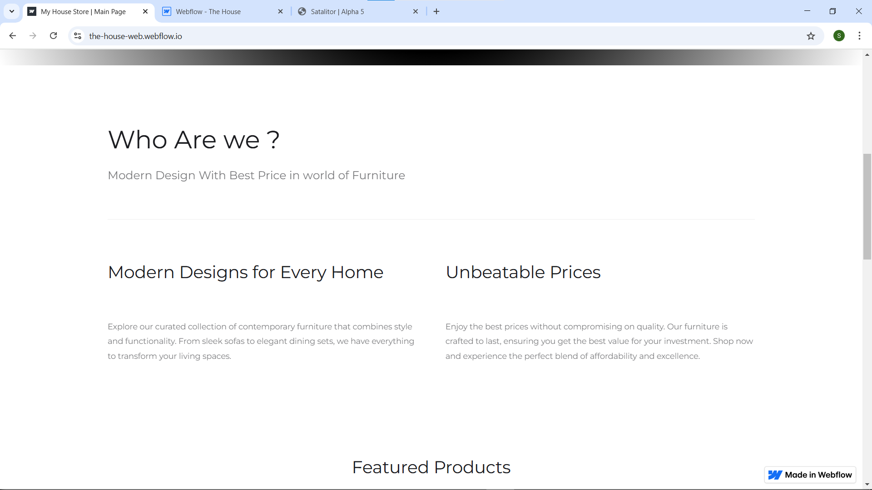

Slide 32
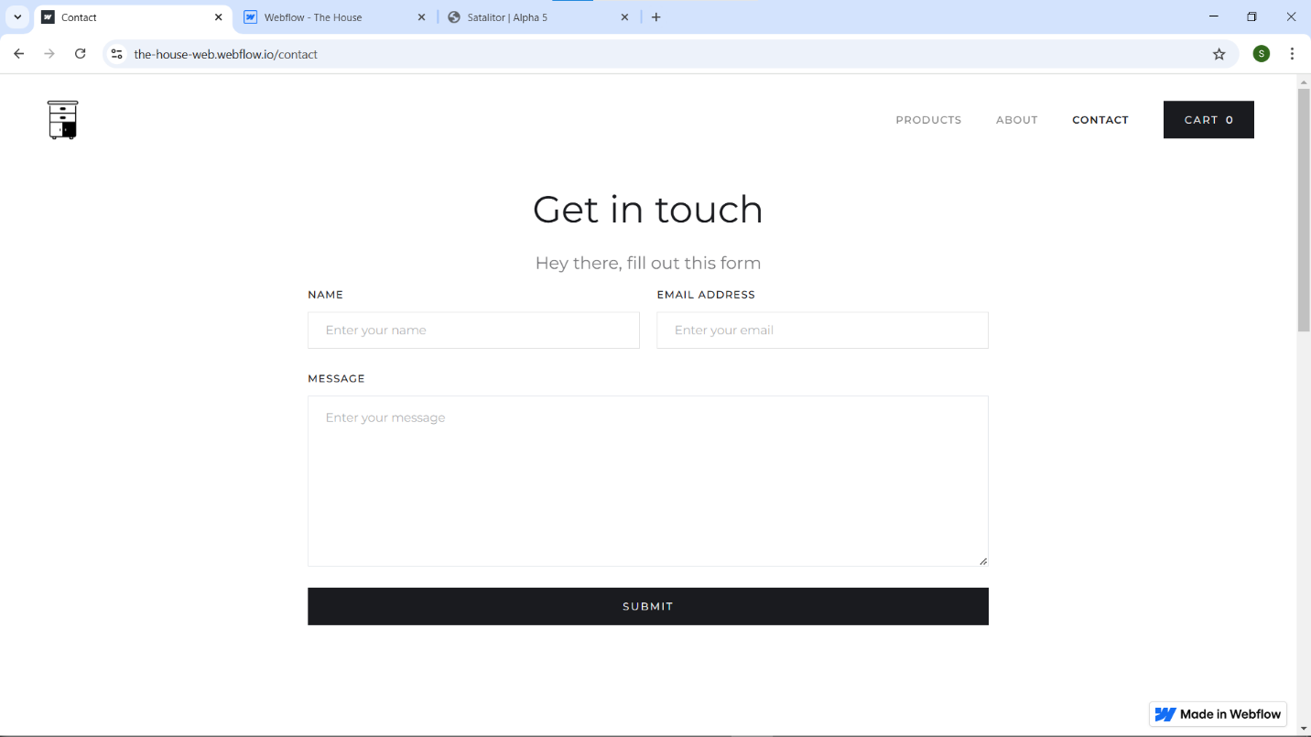

Slide 33
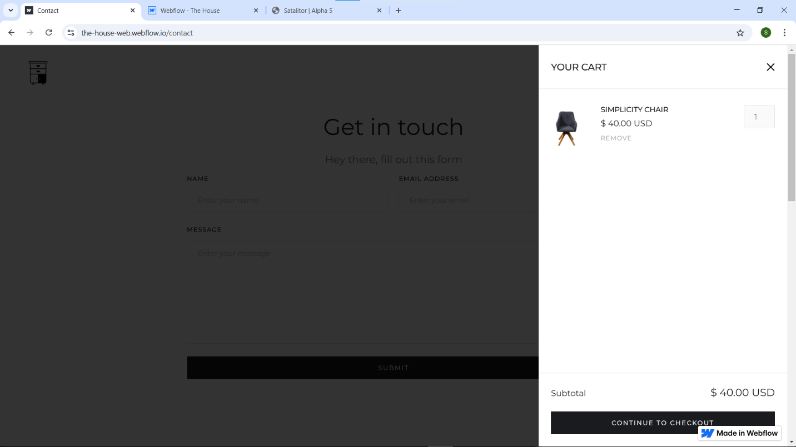

Slide 34
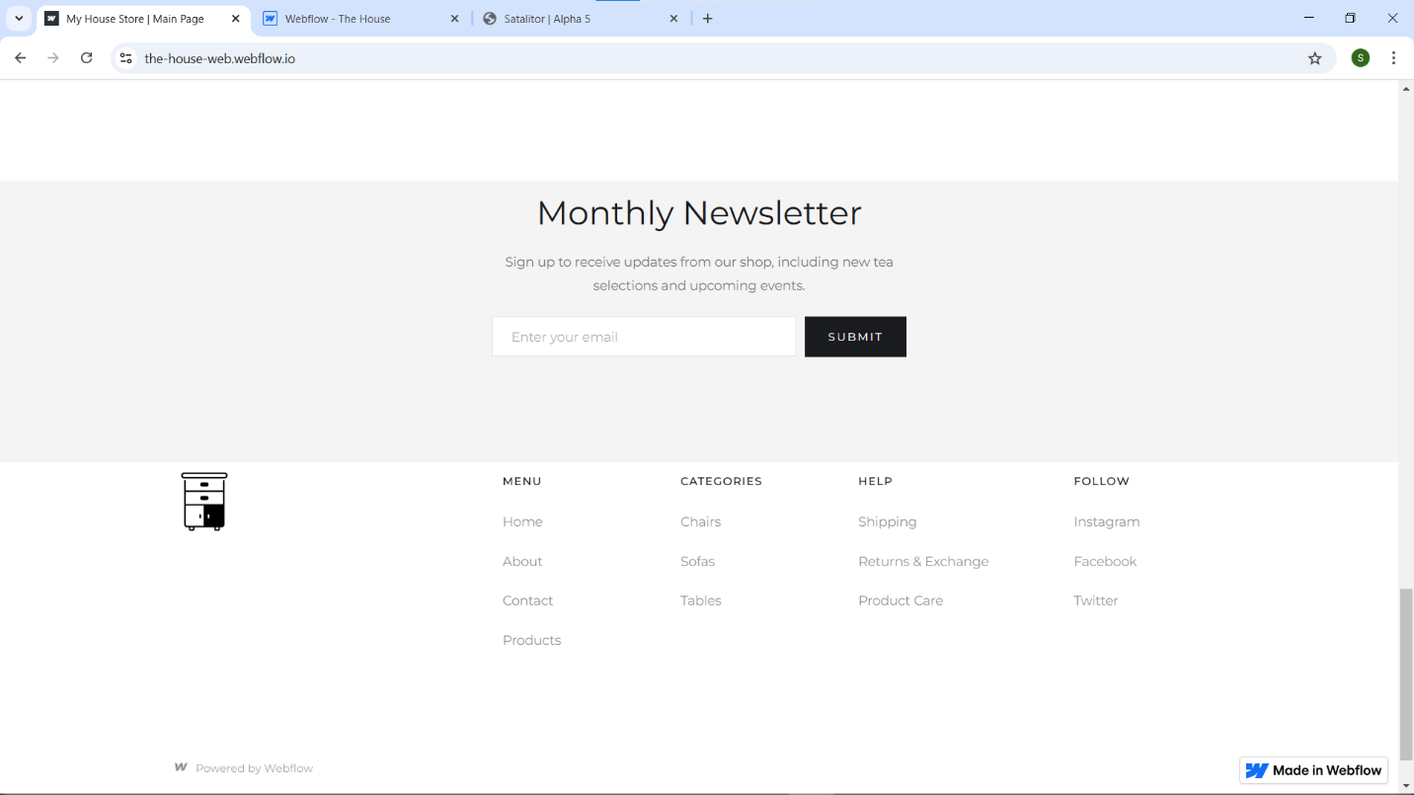

Slide 35
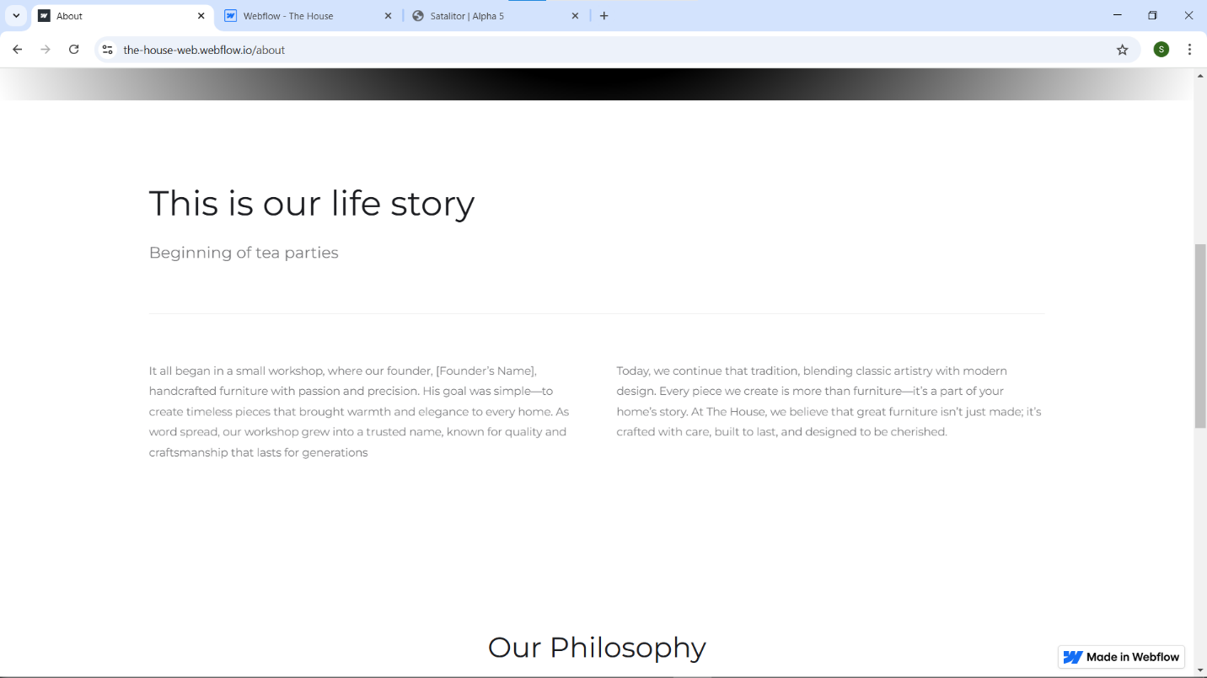

Slide 36
SRS Report Personal Investment Management Software

Slide 37
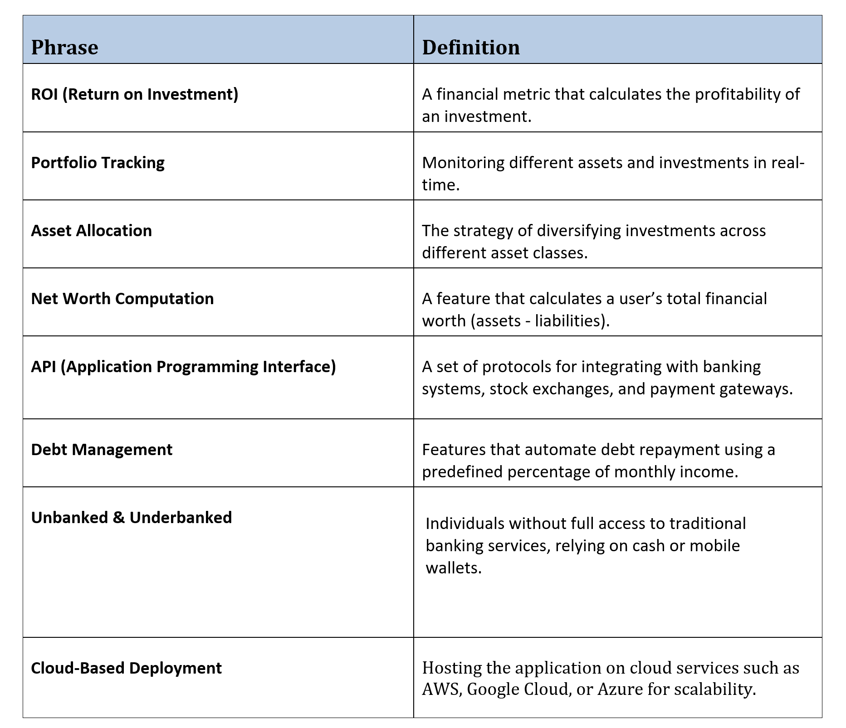

Slide 38
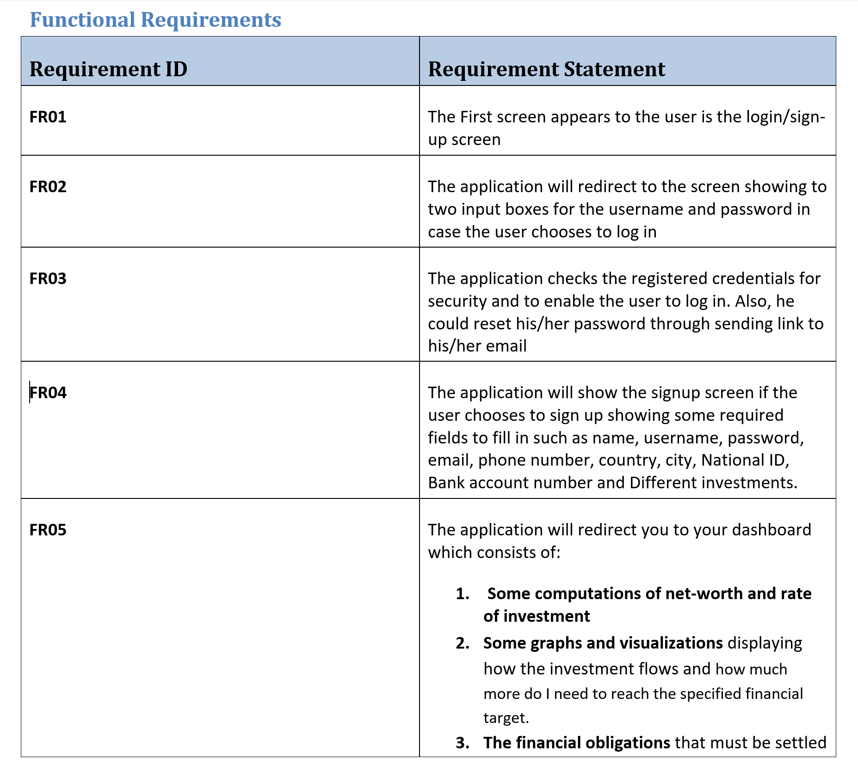

Slide 40
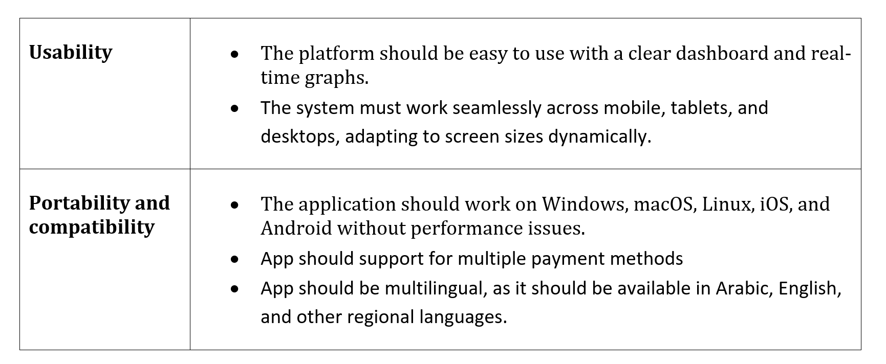

Slide 41
